Slide 1
DNSSEC Case Study
Emily Gao, Maggie Van Nortwick, Rahul Toppur
Notes:
Maggie

Slide 2
What we’ll be covering:
Problem & objectives
DNSSEC overview: benefits & adoption
Methodology
Obstacles
TLD findings
delv & whois overview
Evaluation plan & metrics
Data visualizations
Conclusions
Remaining Steps
Notes:
Maggie

Slide 3
The Problem
DNSSEC: great but not mandatory
Uploading DS records is tricky for sites
getting DS record to parent zone requires passing it through registry
domain owners can’t access registry directly, need to go through registrar organization
Registrar must have methods for domain owners to upload DS records
If not, can’t provide DS records to their parent zones
domains can’t support DNSSEC even if they want to
Thus both the domain and the registrar need to enable it
Notes:
Maggie

Slide 4
Our Objective
Gather metrics to perform a case study on the adoption of DNSSEC
Restrict collection of data to the top 1 million domains
Gain greater insight into emerging trends and DNSSEC adoption based on the following factors:
Whether DNSSEC is fully, partially, or not supported for a given domain
Country associated with each domain
Site categorization (shopping, finance, entertainment)
Buckets based on site popularity ranking
Notes:
Maggie

Slide 5
DNSSEC Benefits
DNS on its own is vulnerable
Spoofing, Cache-poisoning, Man-in-the-middle, Kaminsky attacks
DNSSEC helps protect against these
uses public key cryptography and digital signatures
verifies DNS message authenticity between zones
Guarantees data origin authentication
Checking keys and signatures proves data is from the zone it says its from
Guarantees data integrity protection
Verifying signatures proves data hasn’t been modified in transit
Notes:
Maggie

Slide 6
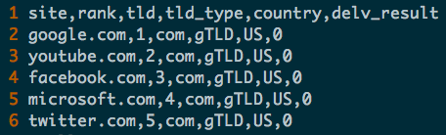
Methodology
Starting with Tranco 1M
Issuing delv queries to get DNSSEC data
Filtering domains to get generic TLDs
Running whois queries for appropriate domains
Creating a master dataset
Repeat process for site-categorization specific domains
Create visualizations and make conclusions
Notes:
Rahul

Slide 7
Obstacles
1M is a big number!
It takes time to run delv and whois queries
Necessary to make use of multithreading to speed up this process
Had to break up data among us and make use of multiple cores on khoury servers
Whois database limits the number of requests you can send
Necessary to sleep for a short period in between each query
Normalizing inconsistencies and data cleaning
Country codes
Notes:
Rahul

Slide 8
Top-Level Domains
Types:
Country code TLDs:
321,625 sites of 1M
General TLDs:
Generic TLDs, generic-restricted TLDs, sponsored TLDs
677,233 sites of 1M
Other:
Infrastructure TLDs (ARPA), test TLDs, TLDs with non-latin characters, onion
1142 sites of 1M
We only made whois queries for sites in the general TLD category
Notes:
Maggie

Slide 9
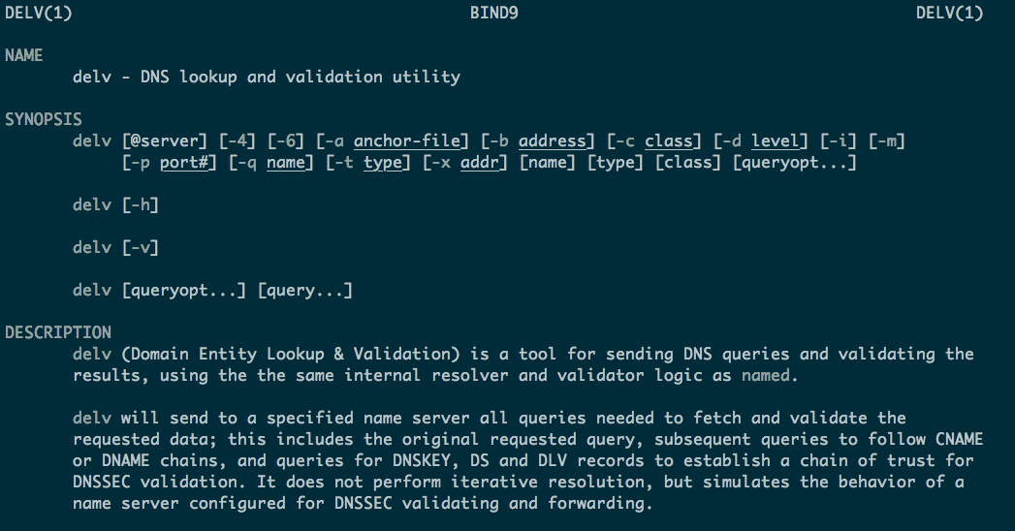
delv
Notes:
Emily

Slide 10
delv
delv is a command line tool for Domain Entity Lookup & Validation, which additionally validates DNSSEC trust chains.
Our script utilizes the +vtrace and +multiline flags
vtrace shows the individual fetches/validation steps
multiline prints long records
Collectively, it took us roughly 54 hours to run the script on 1M entries, as well as repeat the process on entries which fell into none of our categorization buckets.
The script runs delv using Google’s DNS resolver (@8.8.8.8), and writes I/O files based on a csv we split into parts, sourced from Tranco
We ended up with approximately 3.2k domains for which delv failed to resolve
Notes:
Emily

Slide 11
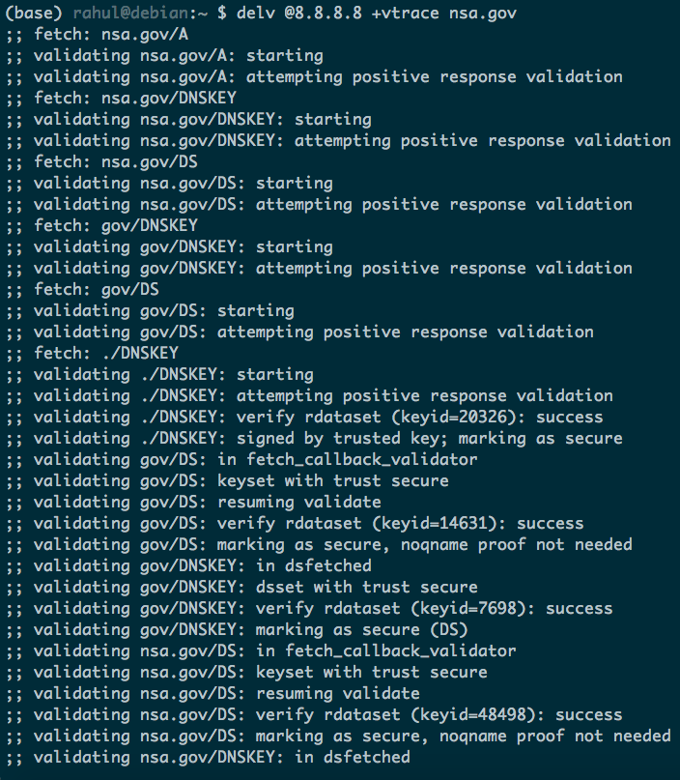
delv @8.8.8.8 +vtrace +multline nsa.gov

Slide 12
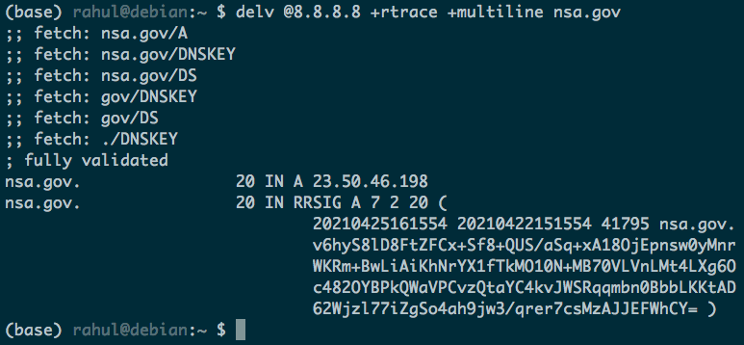
nsa.gov
Notes:
Emily

Slide 13
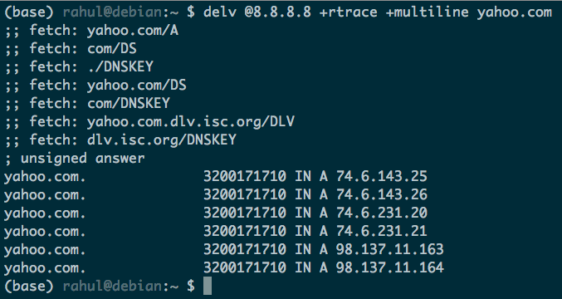
yahoo.com
Notes:
Emily

Slide 14

gembook.jp
Notes:
Emily

Slide 15
delv
We decided on splitting domains up into three categories: fully verified, partially verified, and not verified at all
fully verified DNS trust chains resulted in a ‘fully validated’ message
partially verified chains result in ‘unsigned answer’
fully unverified trust chains result in SERVFAIL messages in stderr
A few of our queries returned resolution failures through timeouts, usually when checking at the SLD phase
We decided not to place them in the partial validation or non-supported category
Notes:
Emily
Usually these cases did have TLDs which were verified to support DNSSEC, but with our own testing, some domains which initially fell into this last category appeared to resolve at later times, so we decided to accept this category as a margin of error

Slide 16
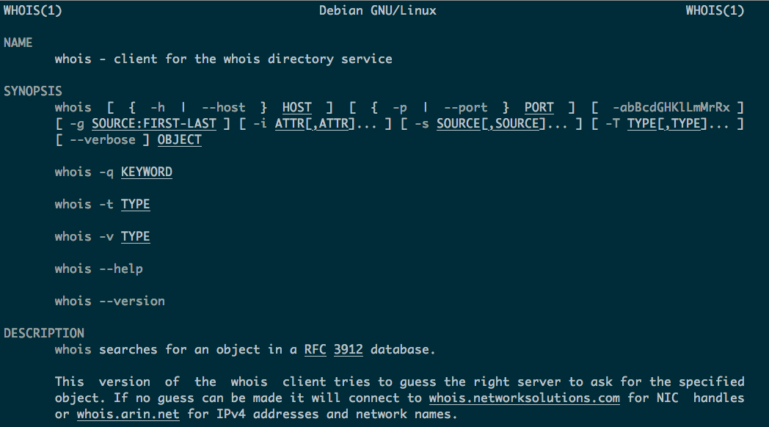
whois
Notes:
Rahul

Slide 17
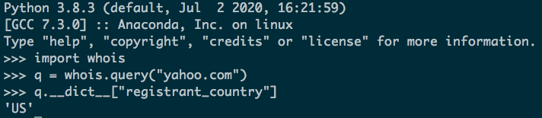
whois
Whois protocol allows queries to WHOIS databases, which contain a listing of all registered domains
Queries are either thick or thin
Thin: Data sufficient to identify sponsoring registrar and status of registration
Thick: Maintains registrant’s contact information
Used python-whois (Python wrapper) to issue queries
Opens a socket and queries the server directly, instead of going through any intermediate web services
Notes:
Rahul

Slide 18
Evaluation Plan and Metrics
Top-level domains for the 100 most popular sites
World heatmap for DNSSEC adoption
DNSSEC adoption per top 25 TLDs
DNSSEC adoption per site categorization
Overall percentage of sites that have fully validated vs. partially validated certificate chains
DNSSEC adoption based on popularity rank
Sites ranked 1-100, 100-1000, etc.
Notes:
Rahul

Slide 19
Visualizations
Notes:
Rahul

Slide 20
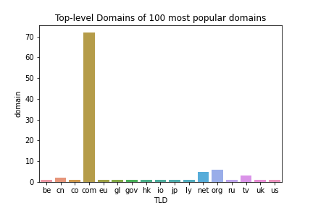
TLDs for the Tranco 100 most popular domains
.com is the most popular TLD by far, making up over 70% of the top 100 domains
Notes:
Emily

Slide 21
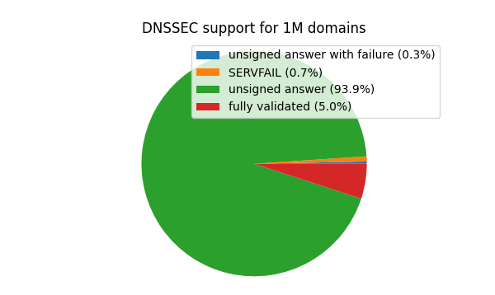
DNSSEC support for Tranco 1M
Most sights have some partial DNSSEC support, but only 5% are fully validated. Only 1% returned an error or had no DNSSEC support
Notes:
Rahul

Slide 22
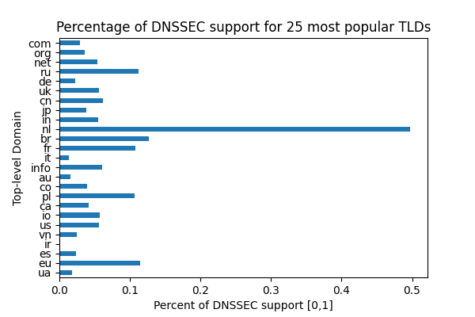
DNSSEC adoption per TLD
General TLDs such as .com have pretty low DNSSEC support, while country code TLDs, such as .nl, more commonly had higher levels of support.
Notes:
Emily
Perhaps this occurs in country code TLDs because of nation-wide infrastructure for DNSSEC, whereas general TLDs may have much less centralized and institutionalized support
We avoid sampling bias (high percentage but extremely small number of domains, x.com only has 2 domains and they both support DNSSEC) by looking at the top 25 TLDs (so they have lots of sites within them)

Slide 23
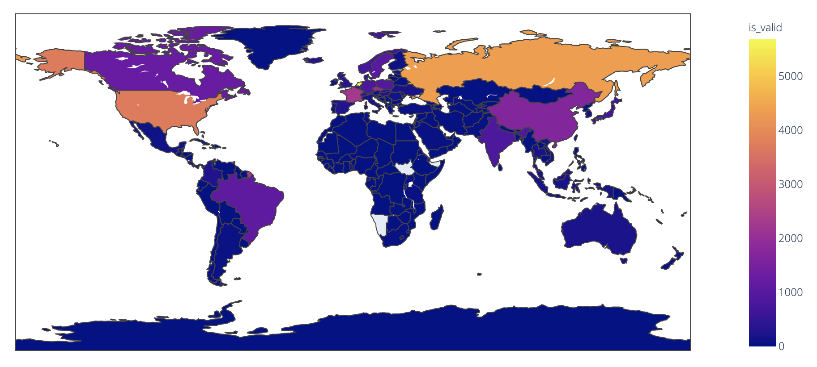
DNSSEC adoption per country
This figure uses country code TLDs and whois query data to determine country of origin for a domain.
Some small countries such as Netherlands have high percentages of fully validated sites, otherwise the countries with the most support tend to be larger ones i.e. Russia, China, India, USA, Brazil, Canada
Notes:
Rahul

Slide 24
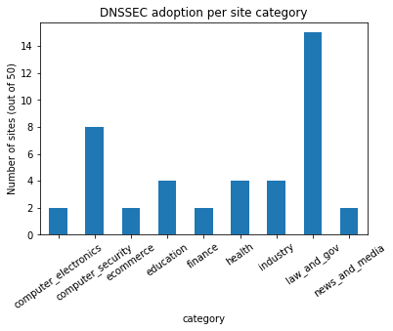
DNSSEC adoption per site category
We’ve sourced these categorizations from similarweb.com
The category with the most DNSSEC support is predictably law and government, followed by computer security
Finance, e-commerce, news and media are surprisingly low
Health, education, and heavy industry somewhere in the middle
Notes:
Rahul
Top 50
Security implications: Computer security and law and gov and doing a good job. Computer security (should have highest). Healthcare (legacy infrastructure and health portals), Finance (sensitive information). Chose more prominent online categories as well.

Slide 25
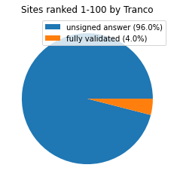
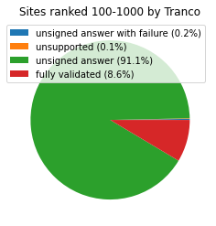
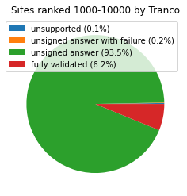
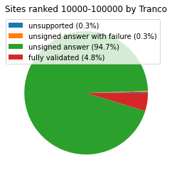
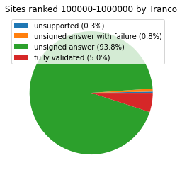
Ranking buckets from Tranco List
Majority of all sites for all buckets was unsigned answer
Top 100 sites had smaller percent of fully validated sites compared to every other bucket
Top 100-1000 sites had the highest percent of fully validated
Percentage of unsupported or unsigned answer with failure minimal for all buckets, but became more significant for buckets of less popular sites
Notes:
Maggie

Slide 26
Conclusions
Full support for DNSSEC is low, but partial support relatively common
Amongst centralized TLDs such as those for countries (not general TLDs), DNSSEC support is often a bit higher
Speculation: nation-wide infrastructure for DNSSEC more effective than decentralized infrastructure like in general TLDs such as .com
Top sites have better DNSSEC support but only marginally
Law and government site category had highest DNSSEC support, followed by computer security site category
Predictable, but we’re glad they’re keeping up
Notes:
Maggie

Slide 27
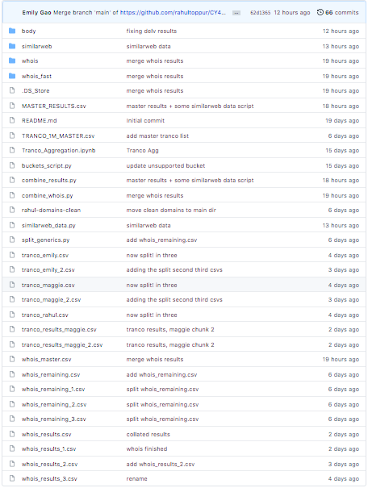
Remaining Steps
Organize our GitHub repository better and clean up our code!
Submit our deliverables!
Notes:
Maggie

Slide 28
References
[1] https://www.icann.org/resources/pages/dnssec-what-is-it-why-important-2019-03-05-en
[2] https://blog.apnic.net/2017/12/06/dnssec-deployment-remains-low/
[3] https://tld-list.com/free-downloads
[4] https://gist.github.com/derlin/421d2bb55018a1538271227ff6b1299d
[5] https://www.ip2location.com/free/country-information
[6] https://en.wikipedia.org/wiki/List_of_Internet_top-level_domains#Types
[7] https://www.similarweb.com/category/
[8] https://tranco-list.eu/
Notes:
Maggie

Slide 29
Thanks for watching!

